Slide 1
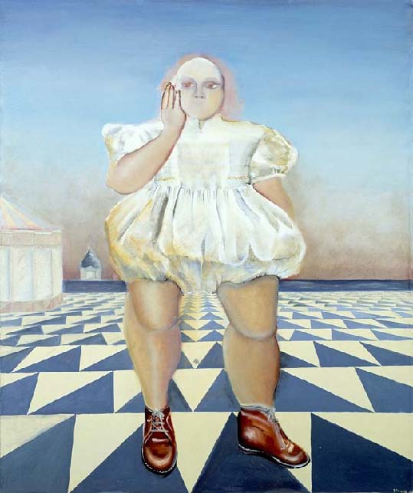
BLACK
PORTRAITURE[S] II
Paris- Florence /
Casamance- Sédhiou
Diagne Chanel’s Italian Renaissance Itinerary
La Poupée merveilleuse ,Oil on canvas,
162x130 cm, 1976, Collection de l'artiste
By Diagne Chanel
Paris, 2013

Slide 2
Diagne Chanel is an international and eclectic artist working with painting, sculpture - strongly inspired by Italian Renaissance - as well as architecture, performance, video and photography…
For the past 10 years, Diagne Chanel has been developing intercultural themes undergoing through French society, including exhibitions in several major international museums and published two children’s books with Paris-Musées, in France.
Chanel’s creative process unveiled the Southern Sudan's genocide, and is involved in numerous human rights campaigns against racism and discrimination.

Slide 3
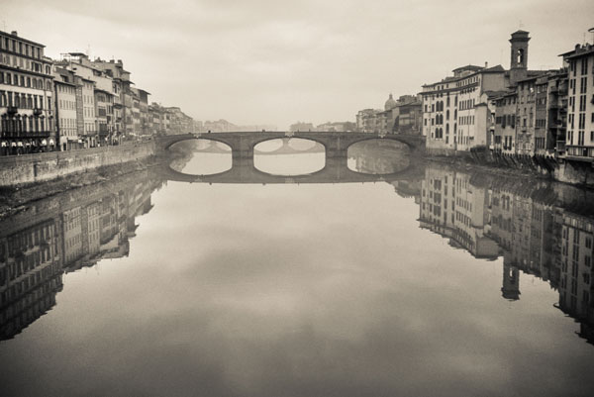
Paris – Florence – Casamance- Sédhiou:
Diagne Chanel’s Italian Renaissance Itinerary
Renaissance in Florence
As a young art student, during a journey to Italy, I discovered Florence and
the delight of Italian Renaissance style.
Thus, the aesthetic astonishment I encountered has been a determining factor in my research for the next 30 years. This was the point of origin of my purpose: to put in conversation the Italian architecture and the representation of black figures standing, most of the time, on a floor laid out in geometrical patterns.
In my paintings, The Lad of Venice, Othello, The Amazing Doll, and The Venetian Dream, the subjective frame and the ‘mise en scene’ of the different characters represent for me the Città ideale. A virtual and perfect model of an 'ideal city' that includes three components: the monument, the square, the heaven.

Slide 4
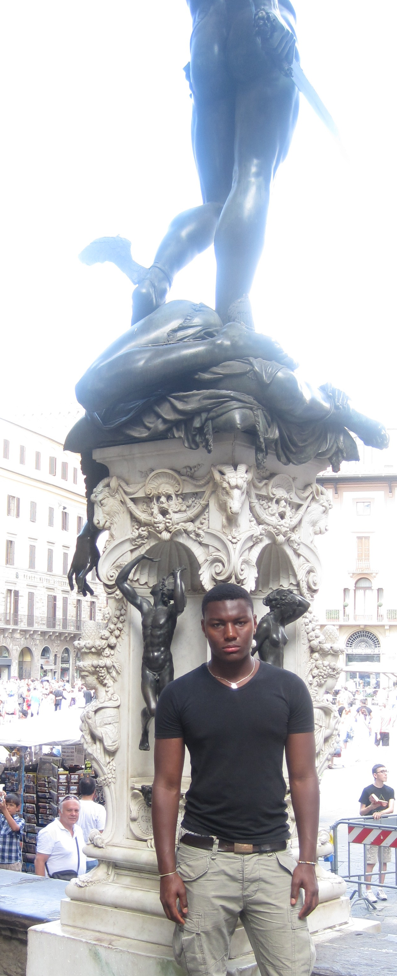
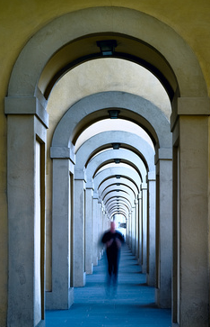
MÉTIS DANS LES VILLES/
METIS IN THE CITIES
At the feet of the Proteus

Slide 5
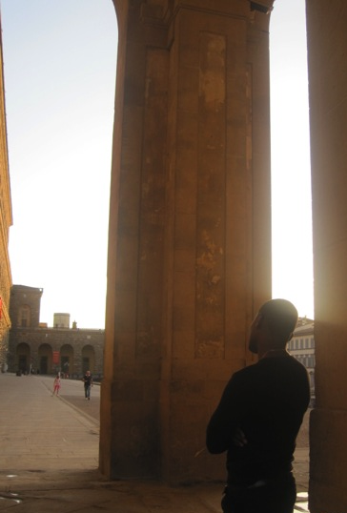
MÉTIS DANS LES VILLES/ METIS IN THE CITIES
Later on, with ‘Métis’ in the cities, I restarted my research in Paris, Rome and Florence, using a new medium: photography. Within the frame of photography, I represent the black body the same way statues are used in Italian cities. In this specific work, the character is standing in front of the Colosseum, the Vatican, and the Pitti Palace.
Métis dans les Villes, Palazzo Pitti, Florence, Italy

Slide 6
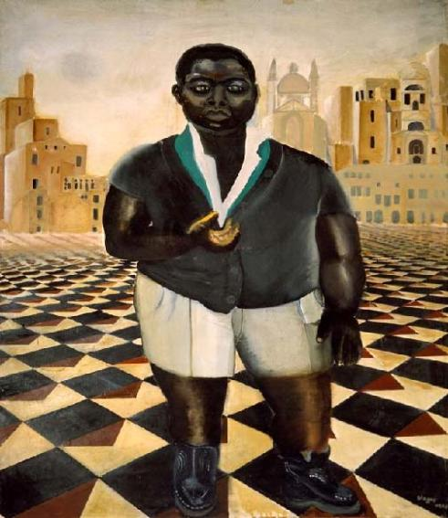
LE GARCON DE VENISE / The Lad of Venice
"…Un enfant noir vêtu à l'occidentale, nous regarde dans ce décor riche d'un passé qui ne lui appartient pas et semble nous demander:
Existe t-il une place pour le fils de l'homme noir sur l'échiquier occidental ? …"
Véronique Hervoüet des Forges, 2001
"Precociously and recurrently, these canvases unveil outstanding perspective structures. Like resurgences of a far-off Renaissance, symbolizing Western horizons. And on these strict wefts, these black and white tiles, like a genesis of hybridity, flourishes the representation, appears the subject, the name: A black child dressed in a Western costume, gazes at us from a rich scenery of a past that does not belong to him; he seems to question us: "Is there a place for the Black man's child on the Western chessboard ?"
Véronique Hervouët des Forges, Casablanca, Morocco, 2001
① Le Garçon de Venise, huile & pigments s/toile, 1976, Collection of the artist, Paris
Notes:
BEBE CRUELS

Slide 7
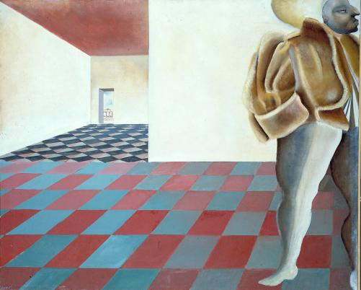
ITALIAN RENAISSANCE ARCHITECTURE &
Palladian Influence In Casamance
During my recent trip to Sédhiou, in Casamance, I went to the domain of Amadou Mapathé Diagne, my grandfather, very first West African writer in French language*. This was an amazing discovery.
The proportions and layout of the house, built near the Casamance river, are almost those of a Palladian villa. Located in a plantation, between town and country, the house reminds me the Villas in Venetia and Tuscany. This surprising linkage to Italian architecture is present in various official buildings through out the city:
• Sédhiou Prefecture,
• Fort Pinet Laprade
• The outdoor theater
Amadou Mapathé Diagne, born in sept. 1886
in Gandiol, Sénégal
Therefore, with Révérence in Casamance, I decided to expand my search, enlightening the relation between the Palladian architecture influence in Sédhiou and the Italian Renaissance style developed by renowned architects and engineers such as Alvise Cornaro and Filippo Brunelleschi. For example, this relation appears obviously in the architecture of the Fort Pined Laprade, an emblematic building dated from the beginning of the French colonization in Africa.
This work was presented at the Lawson Gallery in Paris, in June 2014.

Slide 8
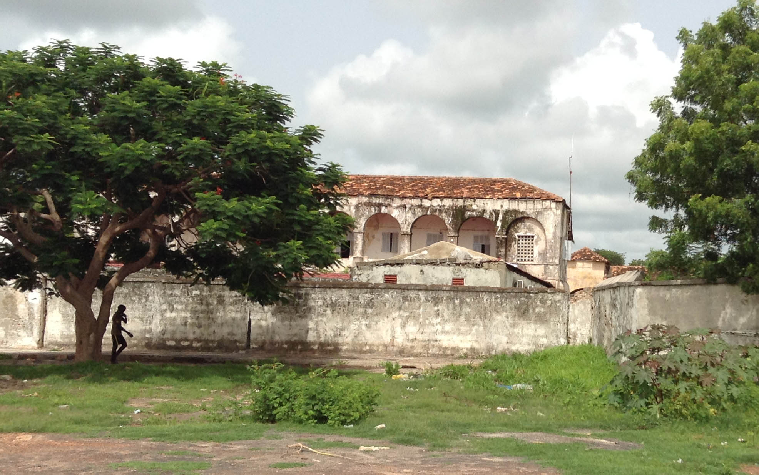

Slide 9
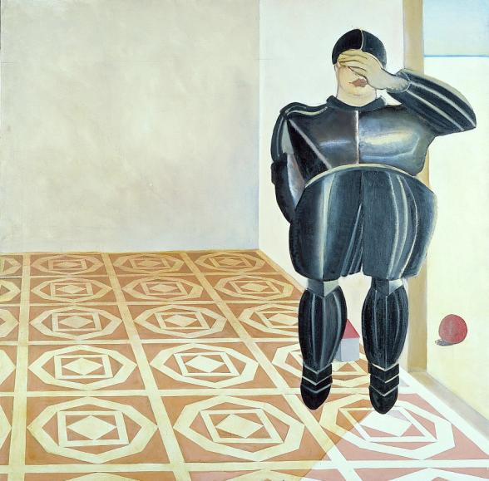
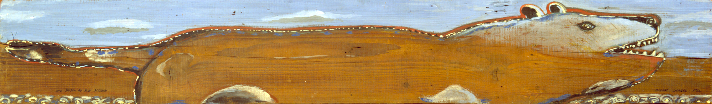
UN RÊVE VÉNITIEN / A Venetian Dream
…Tout droit dans son armure, un grand homme de pierre
se tenait à la barre et coupait le flot noir ;
mais le calme héros, courbé sur sa rapière,
regardait le sillage et ne daignait rien voir.
Ch. Baudelaire, "Don Juan aux Enfers"
…Erect in coat-of-mail, a tall man, hewn of stone,
Stood at the helm, cleaving the black flood.
But in mute pride, leaning upon his sword, impassive and alone, the hero watched the wave nor deigned to look aside.
Charles Baudelaire, "Don Juan in Hell"
Flowers of Evil
Rêve Vénitien / Venetian Dream
(from the Early Paintings Series), Oil on canvas,
162x150 cm, 1978, Collection de l'artiste, Paris

Slide 10
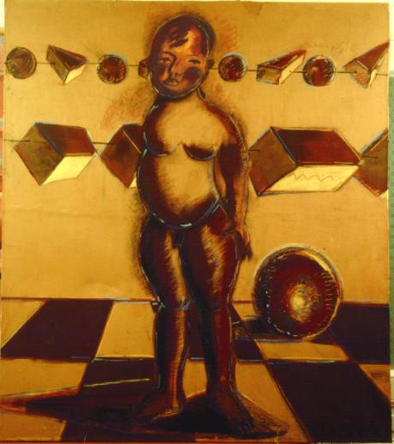
LA FIN D’UN PRIMITIF / The Ending of a Primitive
"Daily life items are preying on Diagne Chanel's mind; trifles dropped on her canvasses as bits and pieces of landscape: small colored cubes, balloons and pyramids nestled in the cradle of the new-born. In order to seize these figures' embodiment as [¿ dis-] located dolls and marionettes…"
Günther Minas, Frankfurt 1999
④
La Fin d'un Primitif 02, 1996, huile acrylique
& pigments sur carton, 120X100cm
Collection privée, Cameroun

Slide 11
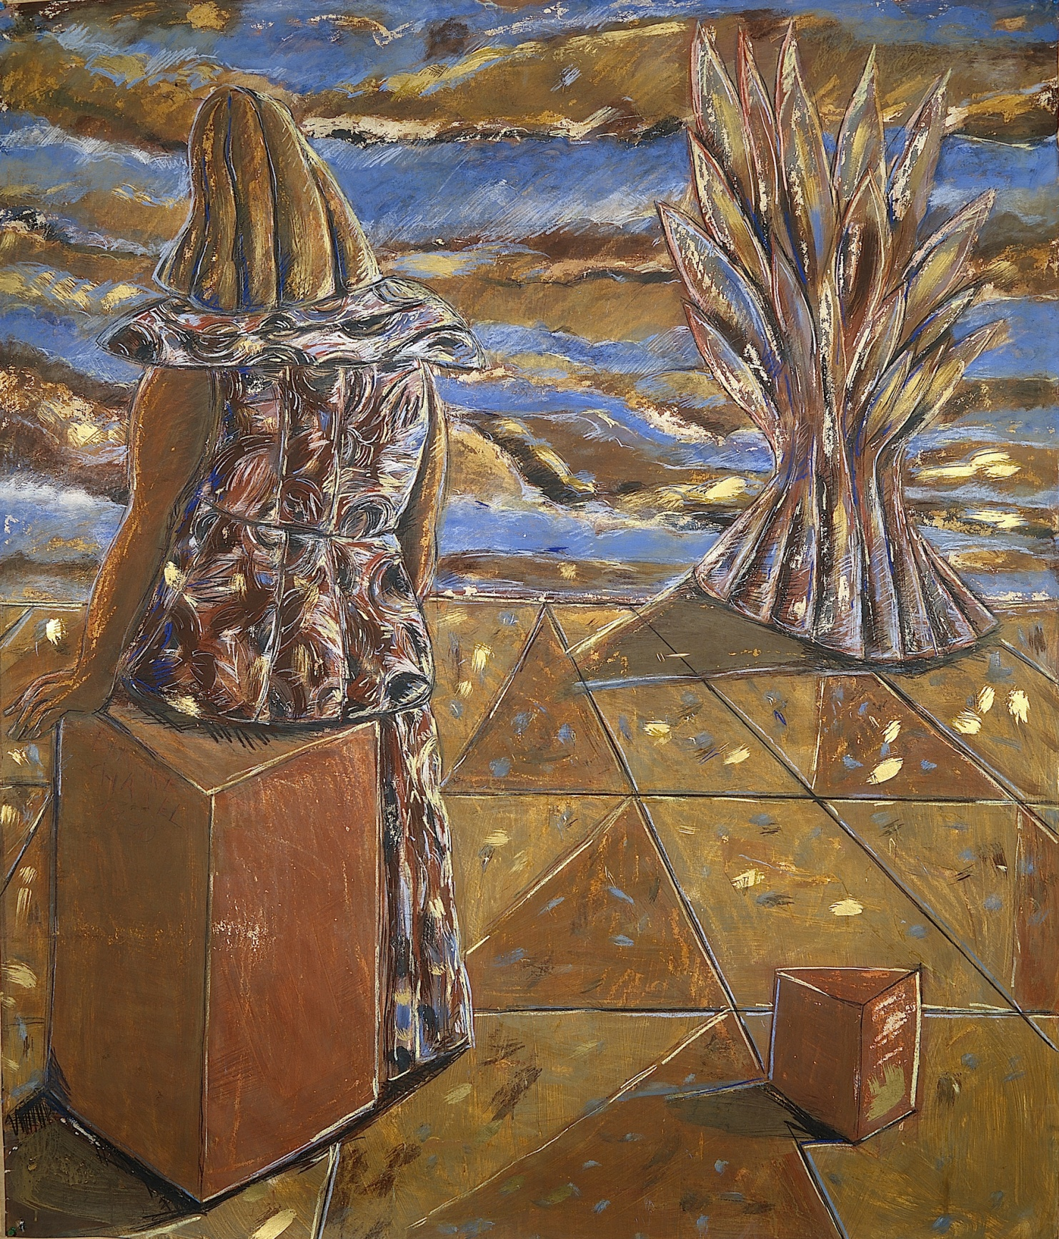
UNE SAISON AU SUD SOUDAN/ A Season in Southern Sudan
I. Pourquoi mourir sous un ciel plein d’étoiles / I. Why dying under a Star filled Sky ?
① Retour d'Afrique
Retour d'Afrique VII, Oil on Canvas,
170X150 cm, 1999
Notes:
LA DISPARITION DU CORPS NOIR

Slide 12
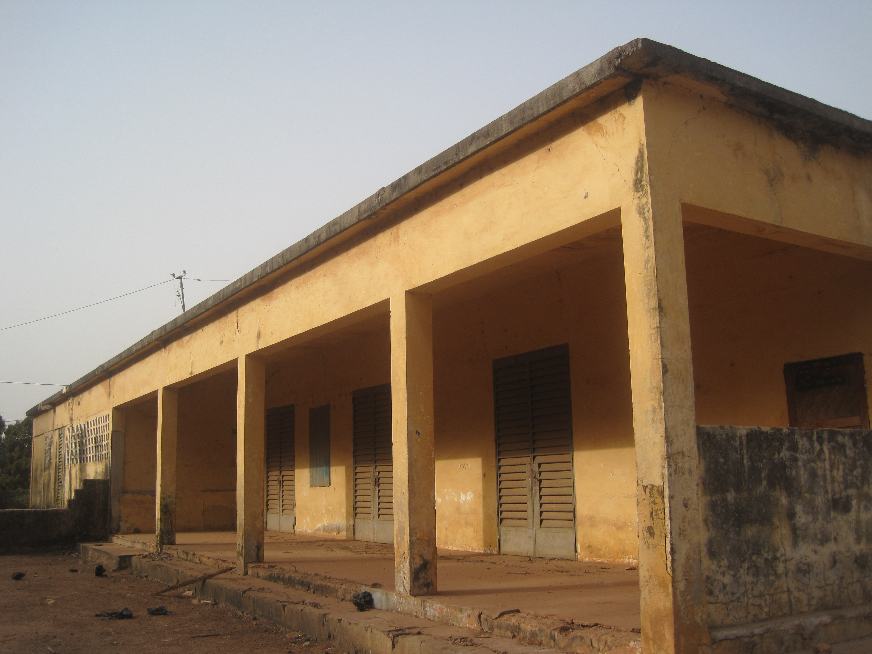
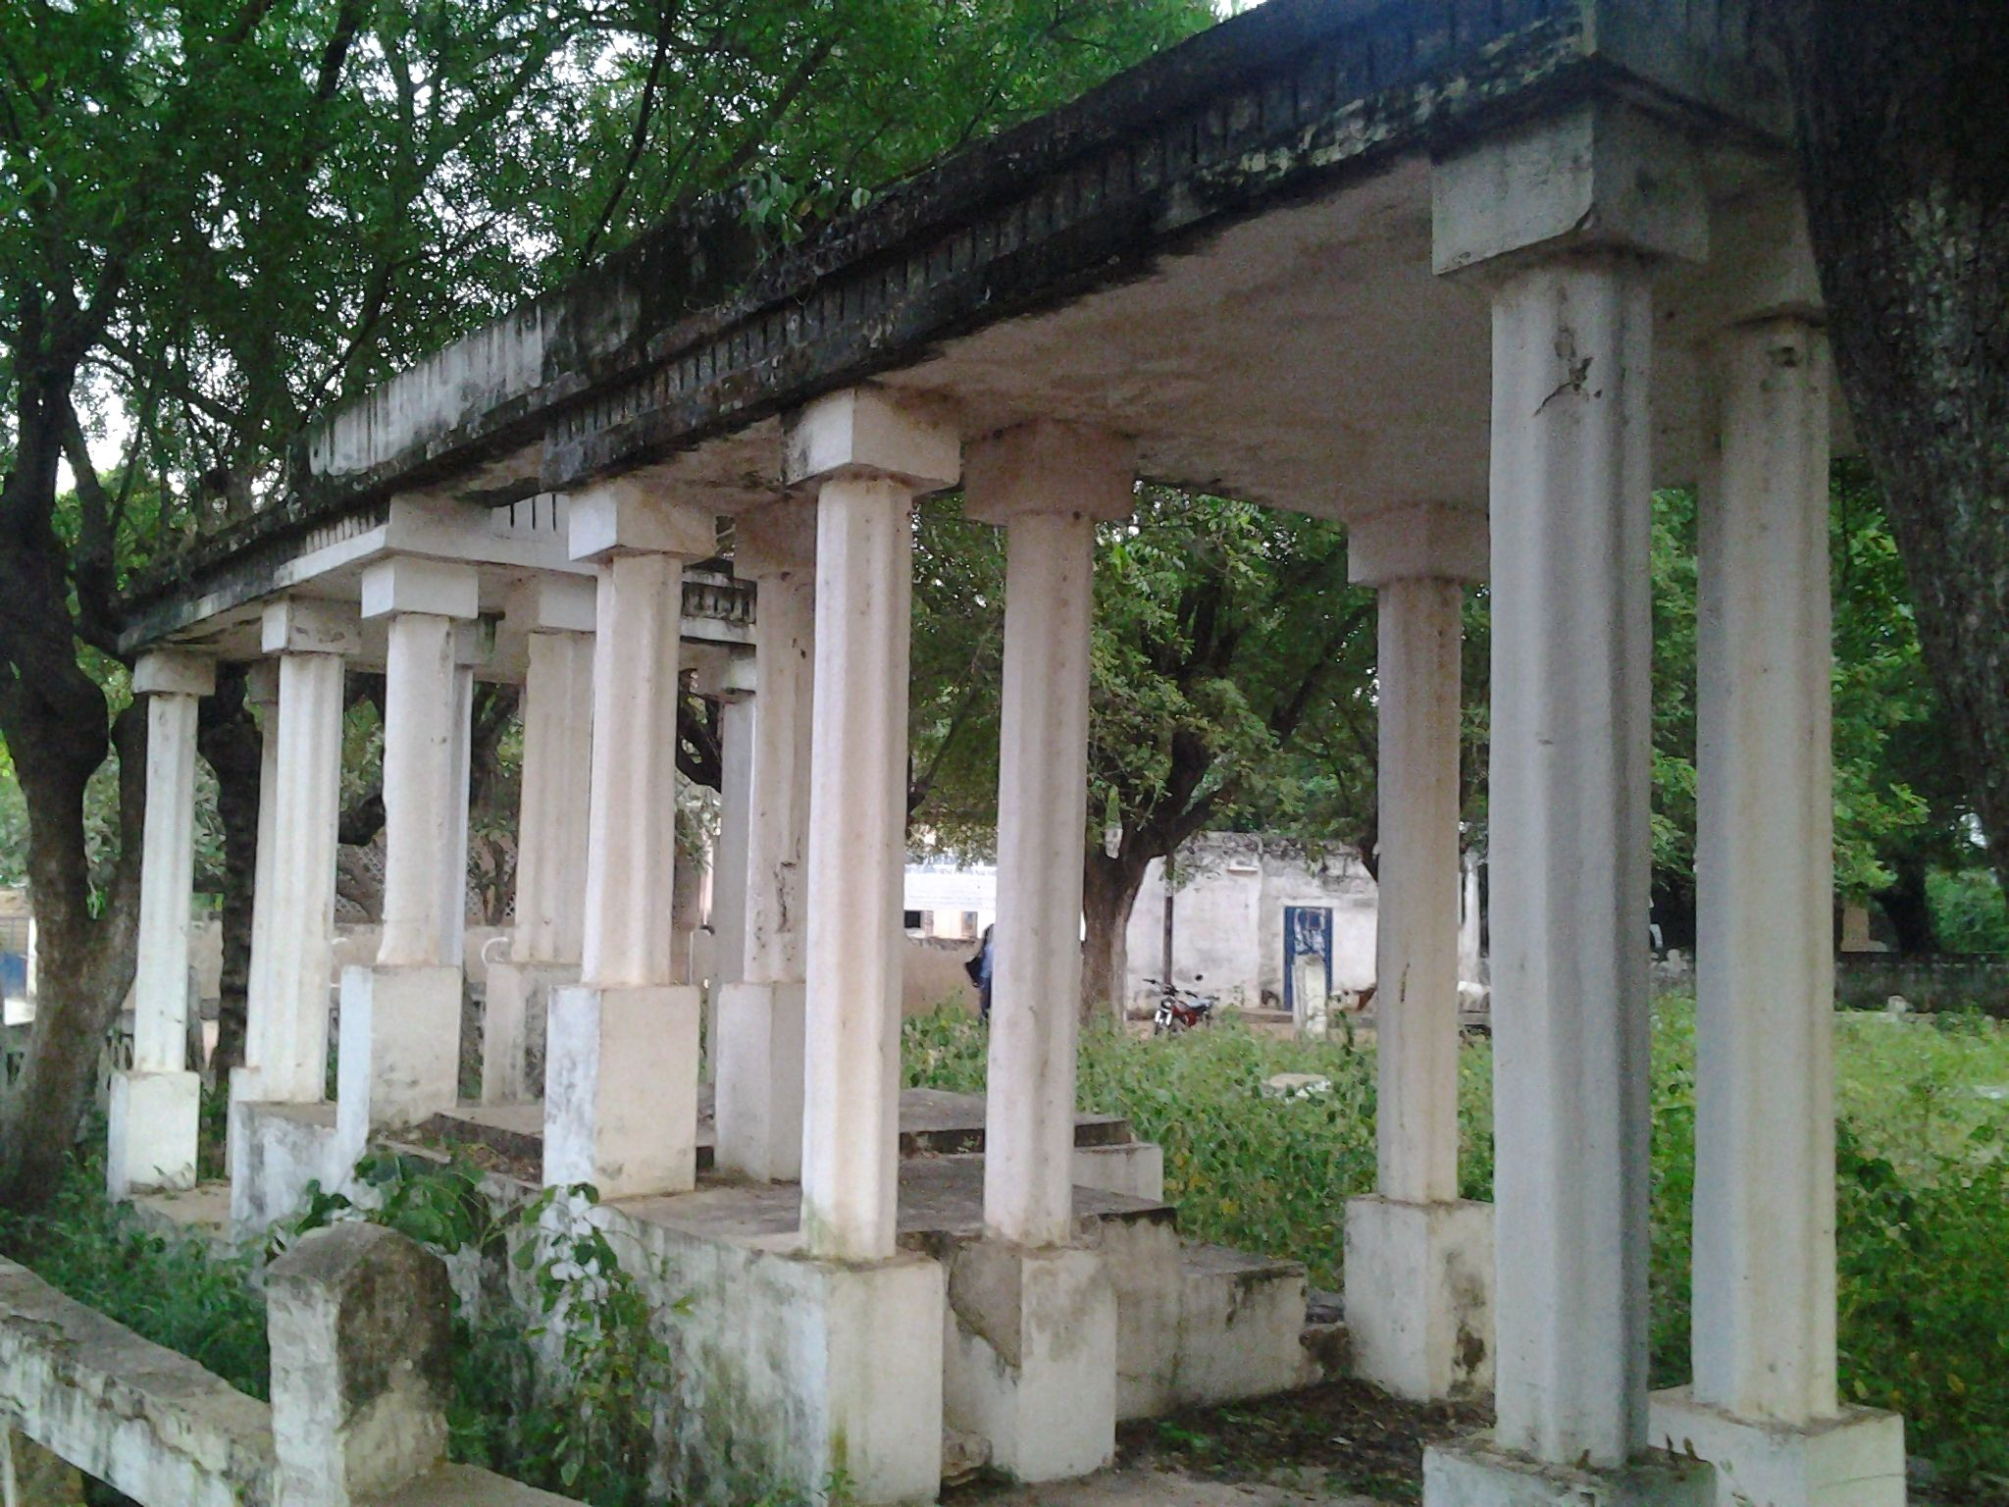
Demeures privées et bâtiments publics de Sédhiou
Private houses and public buildings in Sédhiou
Un théâtre de pierre, où plus rien ne se joue, s’ennuie dans le jardin public déserté.
On s’arrête et me salue d'une antique révérence, vestige d’une tradition passée. Dans ces rues ensablées, où les animaux vivent libres comme à l'âge d’or, la révérence est d'usage pour marquer sa considération.
En Toscane aussi, j'ai croisé de vieilles paysannes qui accompagnaient leur salut silencieux d’une génuflexion inattendue.
Avant le crépuscule, la ville, comme La Casamance devient ce rêve flottant en terre africaine. Un rêve renversé qui bascule dans l’éternité. Là où finit l’arc en ciel, commence la Casamance, Casa di Mansa.
A stone theater without performance gets bored in the deserted garden,.
To emphasize and pay respect, one pauses and bow to greet me graciously with an ancient reverence, remnants of a past tradition. Through the sandy roads, free animals live as in a golden age. In Tuscany as well, I have bumped into old countrywomen who would accompany their greeting nod with the same unexpected bow.
Before twilight, the city, as Casamance, becomes this floating dream on the African land. An overturned dream toppling over eternity. Where the rainbow finishes begins Casamance, Casa di Mansa, the house of the King.

Slide 13
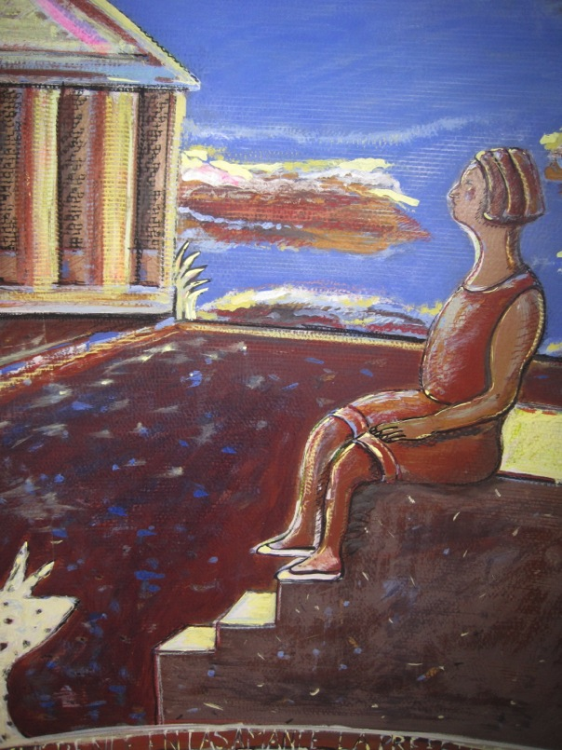
SÉDHIOU, Première capitale administrative de la Casamance et ancien comptoir commercial, survit toujours dans le même décor que celui de 1886. Ville oubliée par l’histoire et le pouvoir central, elle semble ne plus attendre aucun réveil. Pourtant quand vient le soir, renaît sa splendeur.
A l’heure où les ombres s’allongent, j’y reprends mes marches florentines. Après Paris et mes promenades de l’Auvergne, ma marche quotidienne dans la ville continue le long du fleuve, près des loggias de verdure, dans ces avenues vastes comme des voies romaines qui mènent à l’église et au Fort Pinet Laprade… Paris c’est ma ville, Florence aussi, mais Sédhiou aussi commence à m’appartenir.
SEDHIOU, forgotten by history and the central power Casamance's early administrative capital and former trading post, still survives in the very same 1886 backdrop, no longer expects to be awaken. When evening comes, its glorious splendor springs up again.
When the shadows grow longer I go back to my Florentine walks, after Paris and my promenades in Auvergne, I continue my daily urban wanderings along the Casamance River, on its large avenues as Roman roads taking me to the Church and to Pinet Laprade Fort, Paris, Florence my cities, and now Sédhiou belongs to me as well…

Slide 14
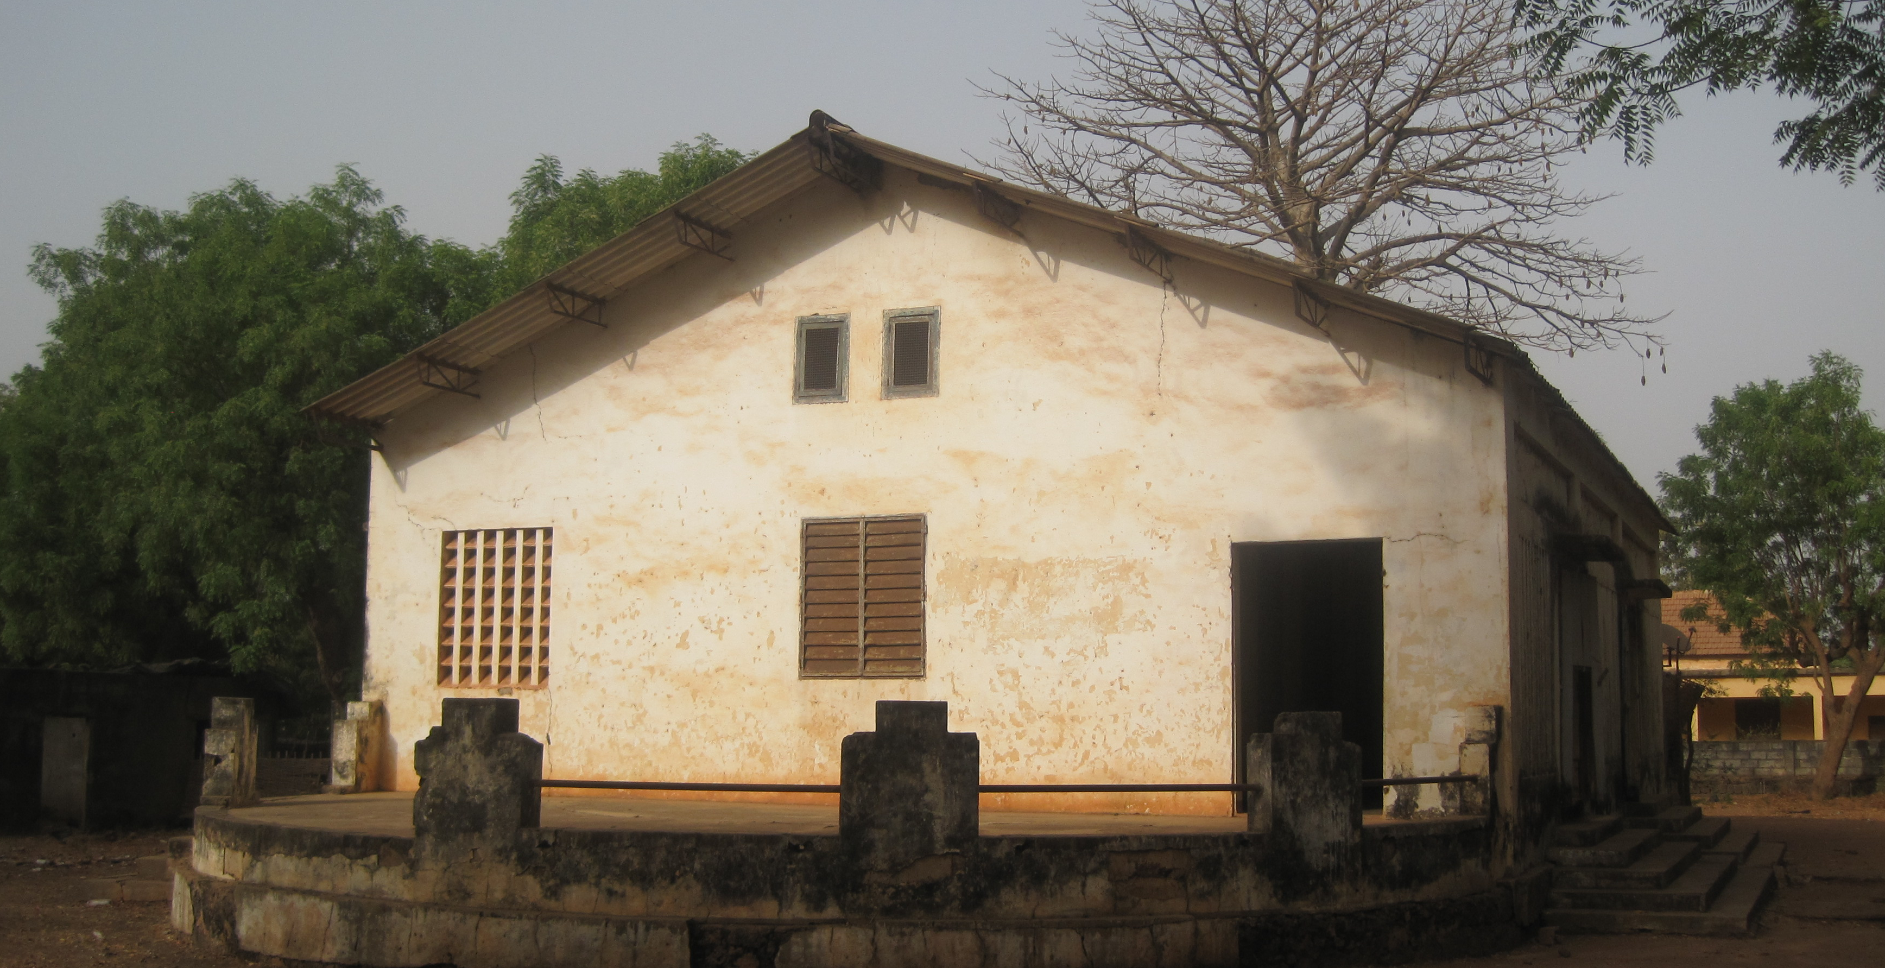
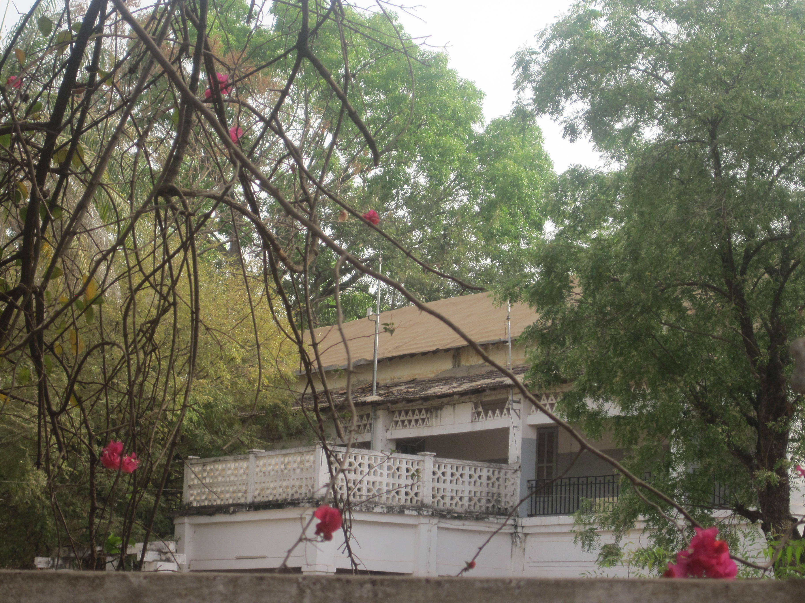
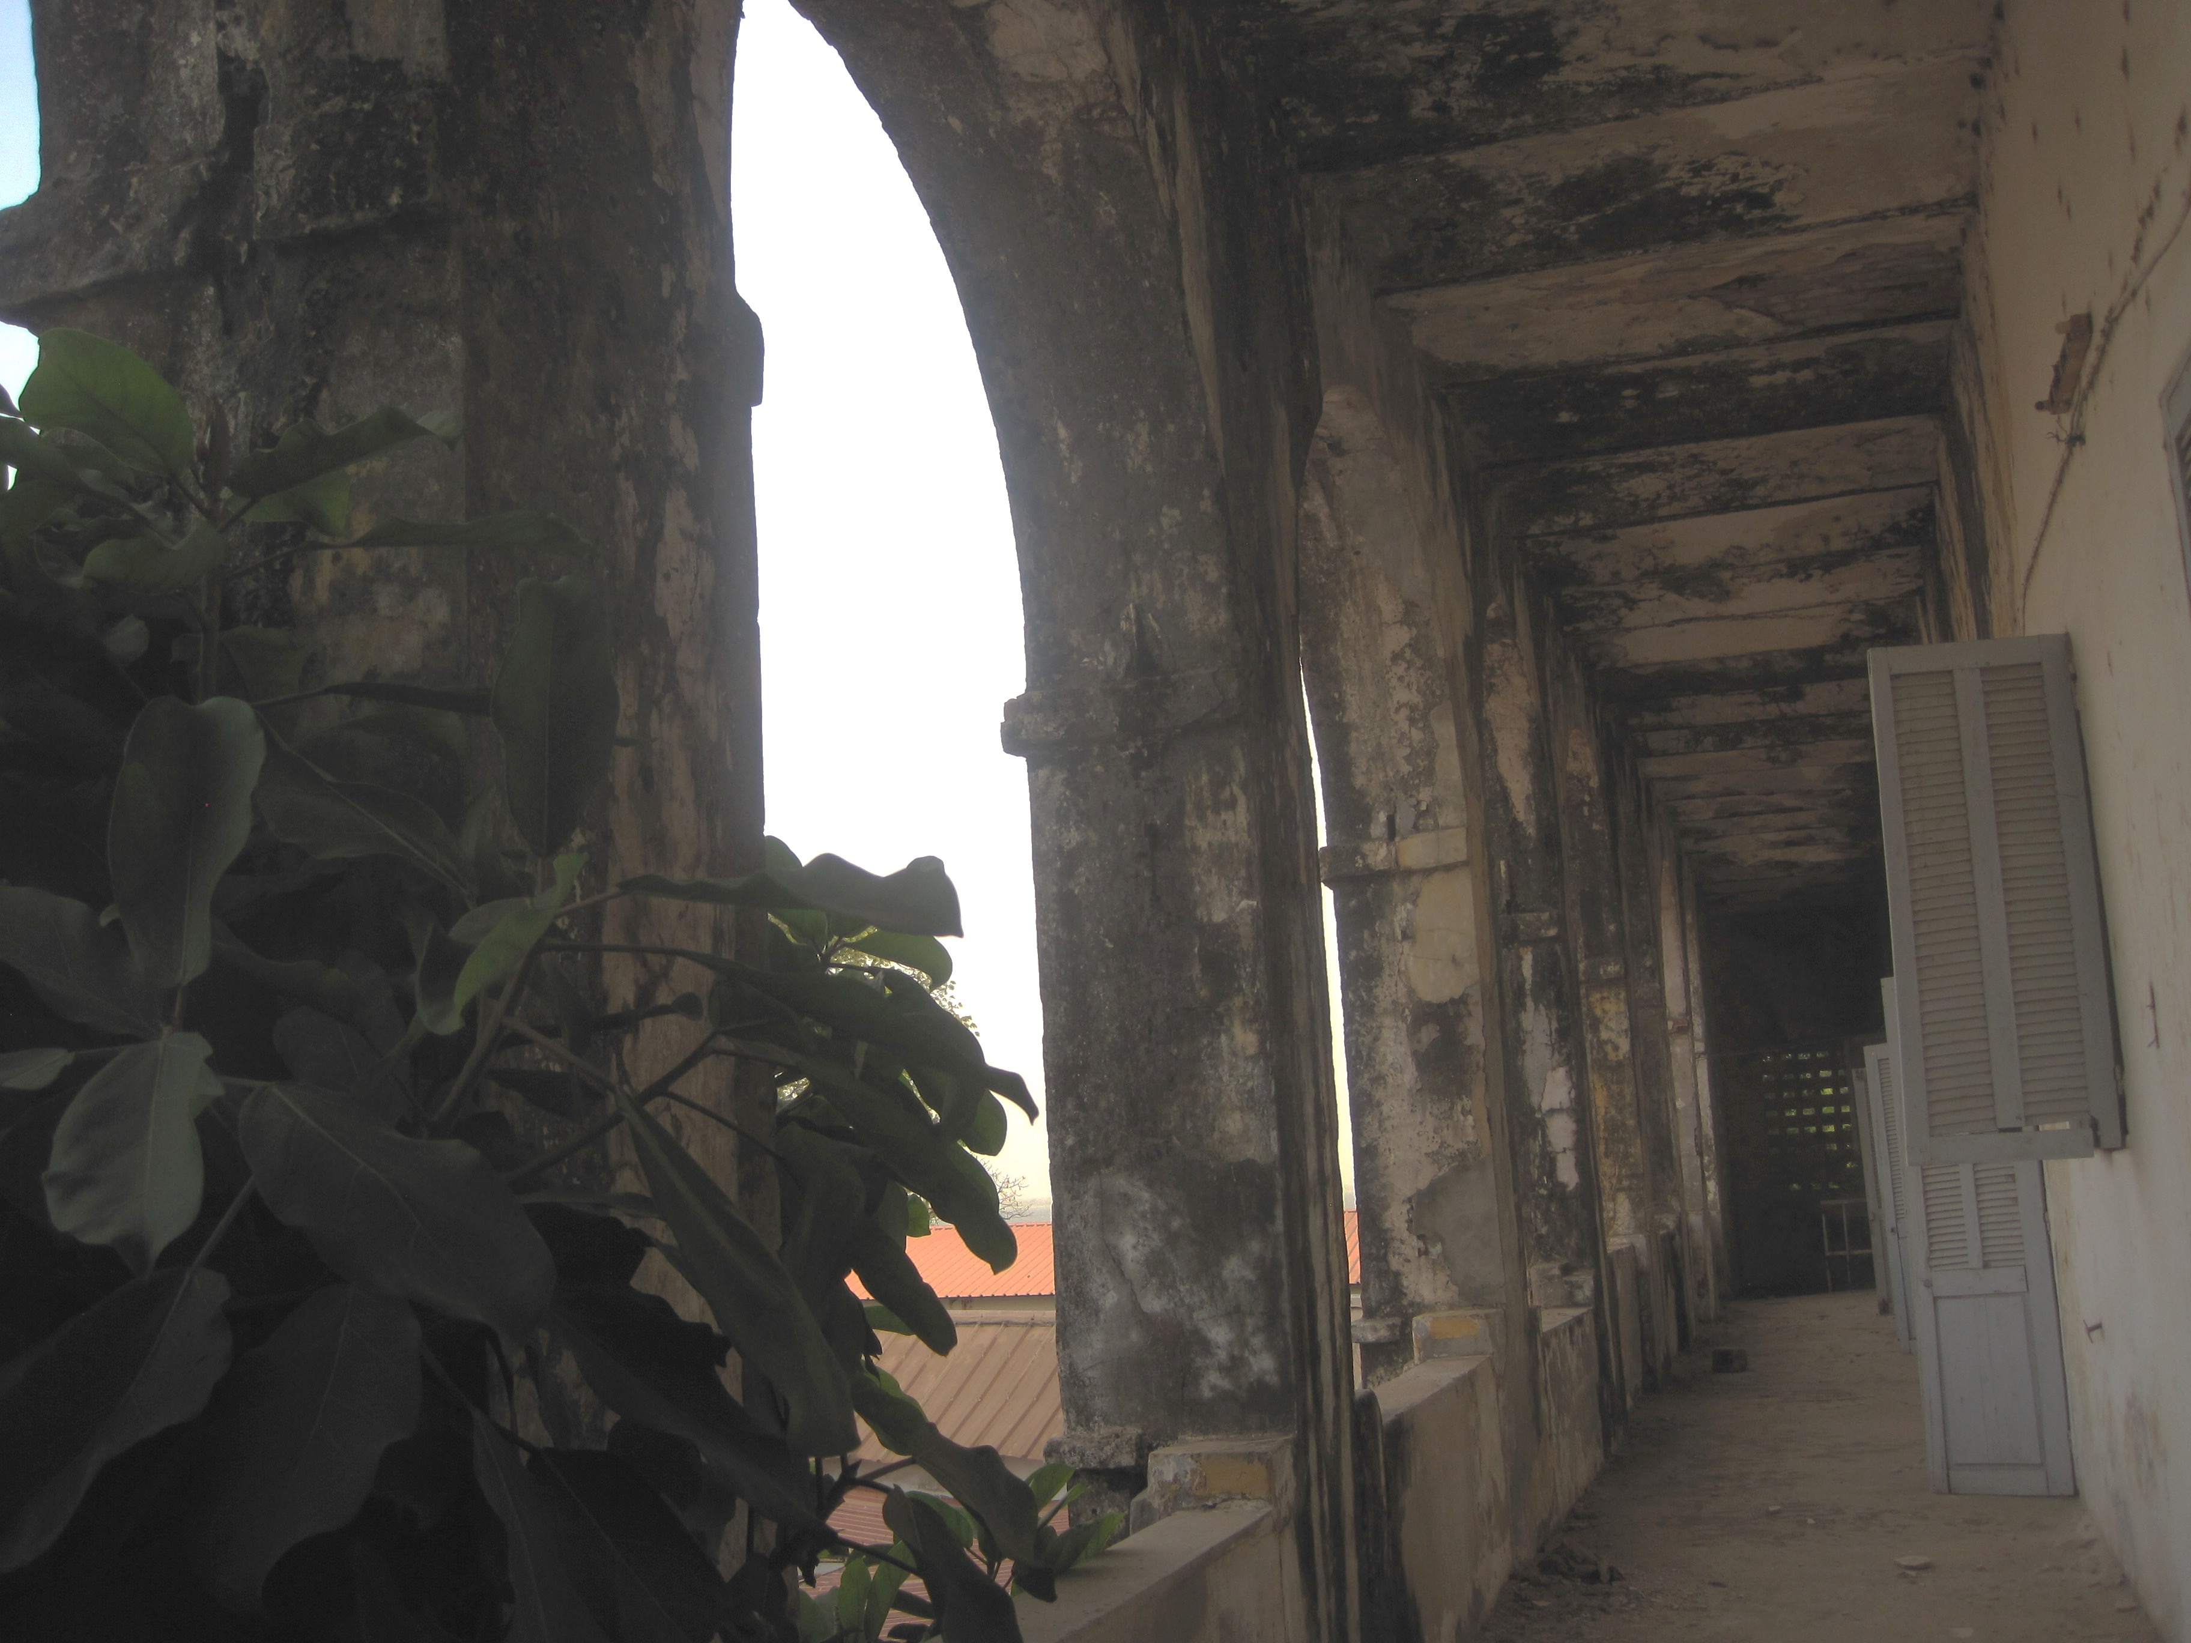
Demeures privées et bâtiments publics de Sédhiou
Private houses and public buildings in Sédhiou

Slide 15
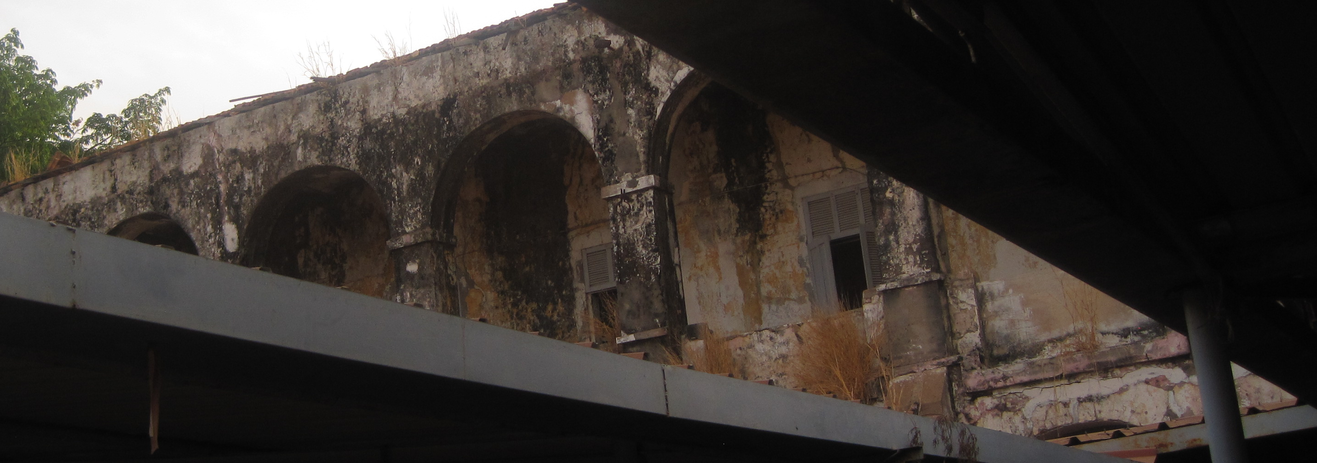
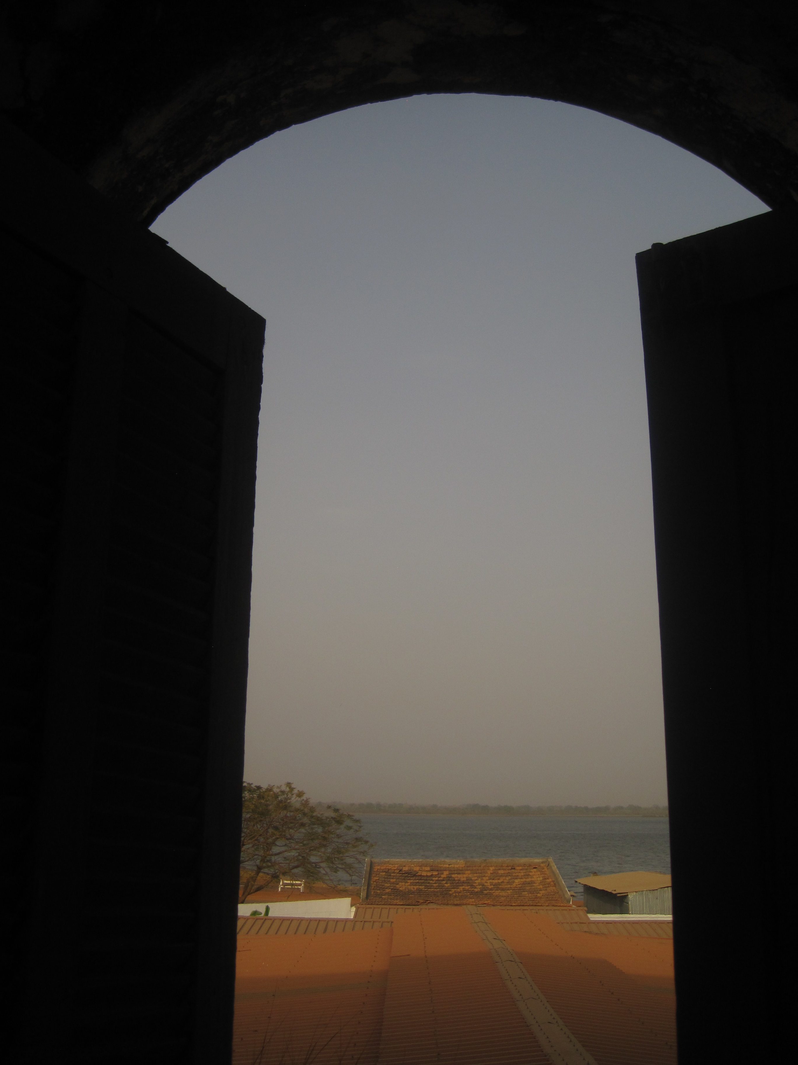
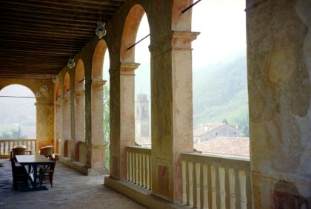
L'ARCHITECTURE ITALIENNE DE SÉDHIOU
ITALIAN ARCHITECTURE RESURGENCE
Le Fort Pinet Laprade, vestige de l'empire colonial, construit en 1836
Fort Pinet Laprade, a vestige of the colonial empire built in 1836 on the Casamance River
Le Fort Pinet Laprade Loggia italienne

Slide 16
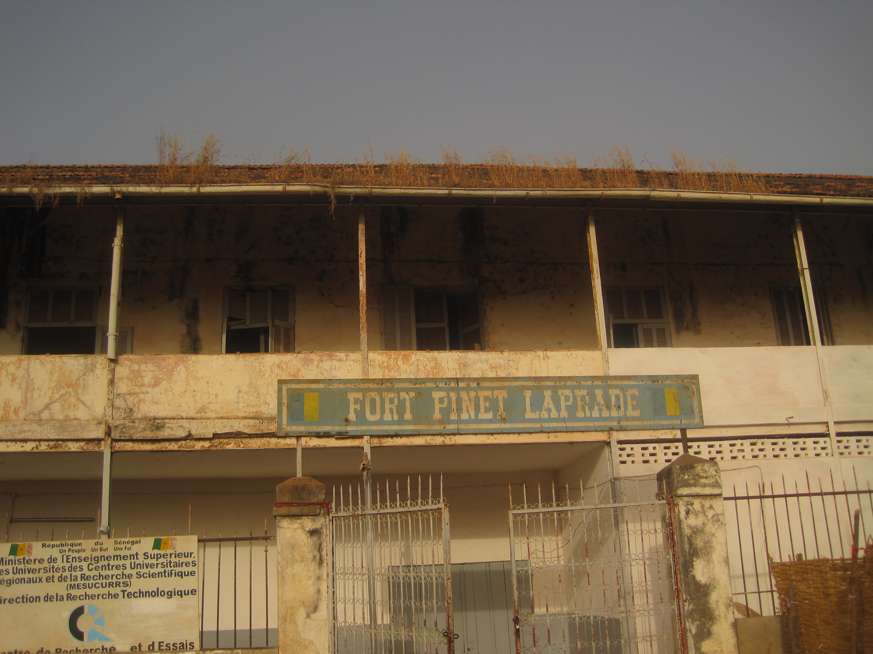
PRÉSENCE PALLADIENNE EN CASAMANCE
ITALIAN ARCHITECTURE RESURGENCE

Slide 17
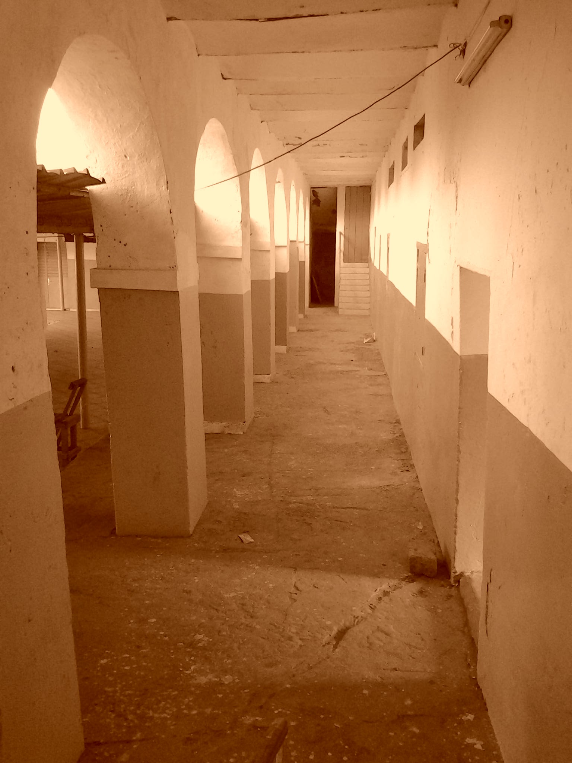
L'ARCHITECTURE ITALIENNE DE SÉDHIOU
ITALIAN ARCHITECTURE RESURGENCE
Le Fort Pinet Laprade (1836) 1er étage
Fort Pinet Laprade (1836) 1st floor

Slide 18
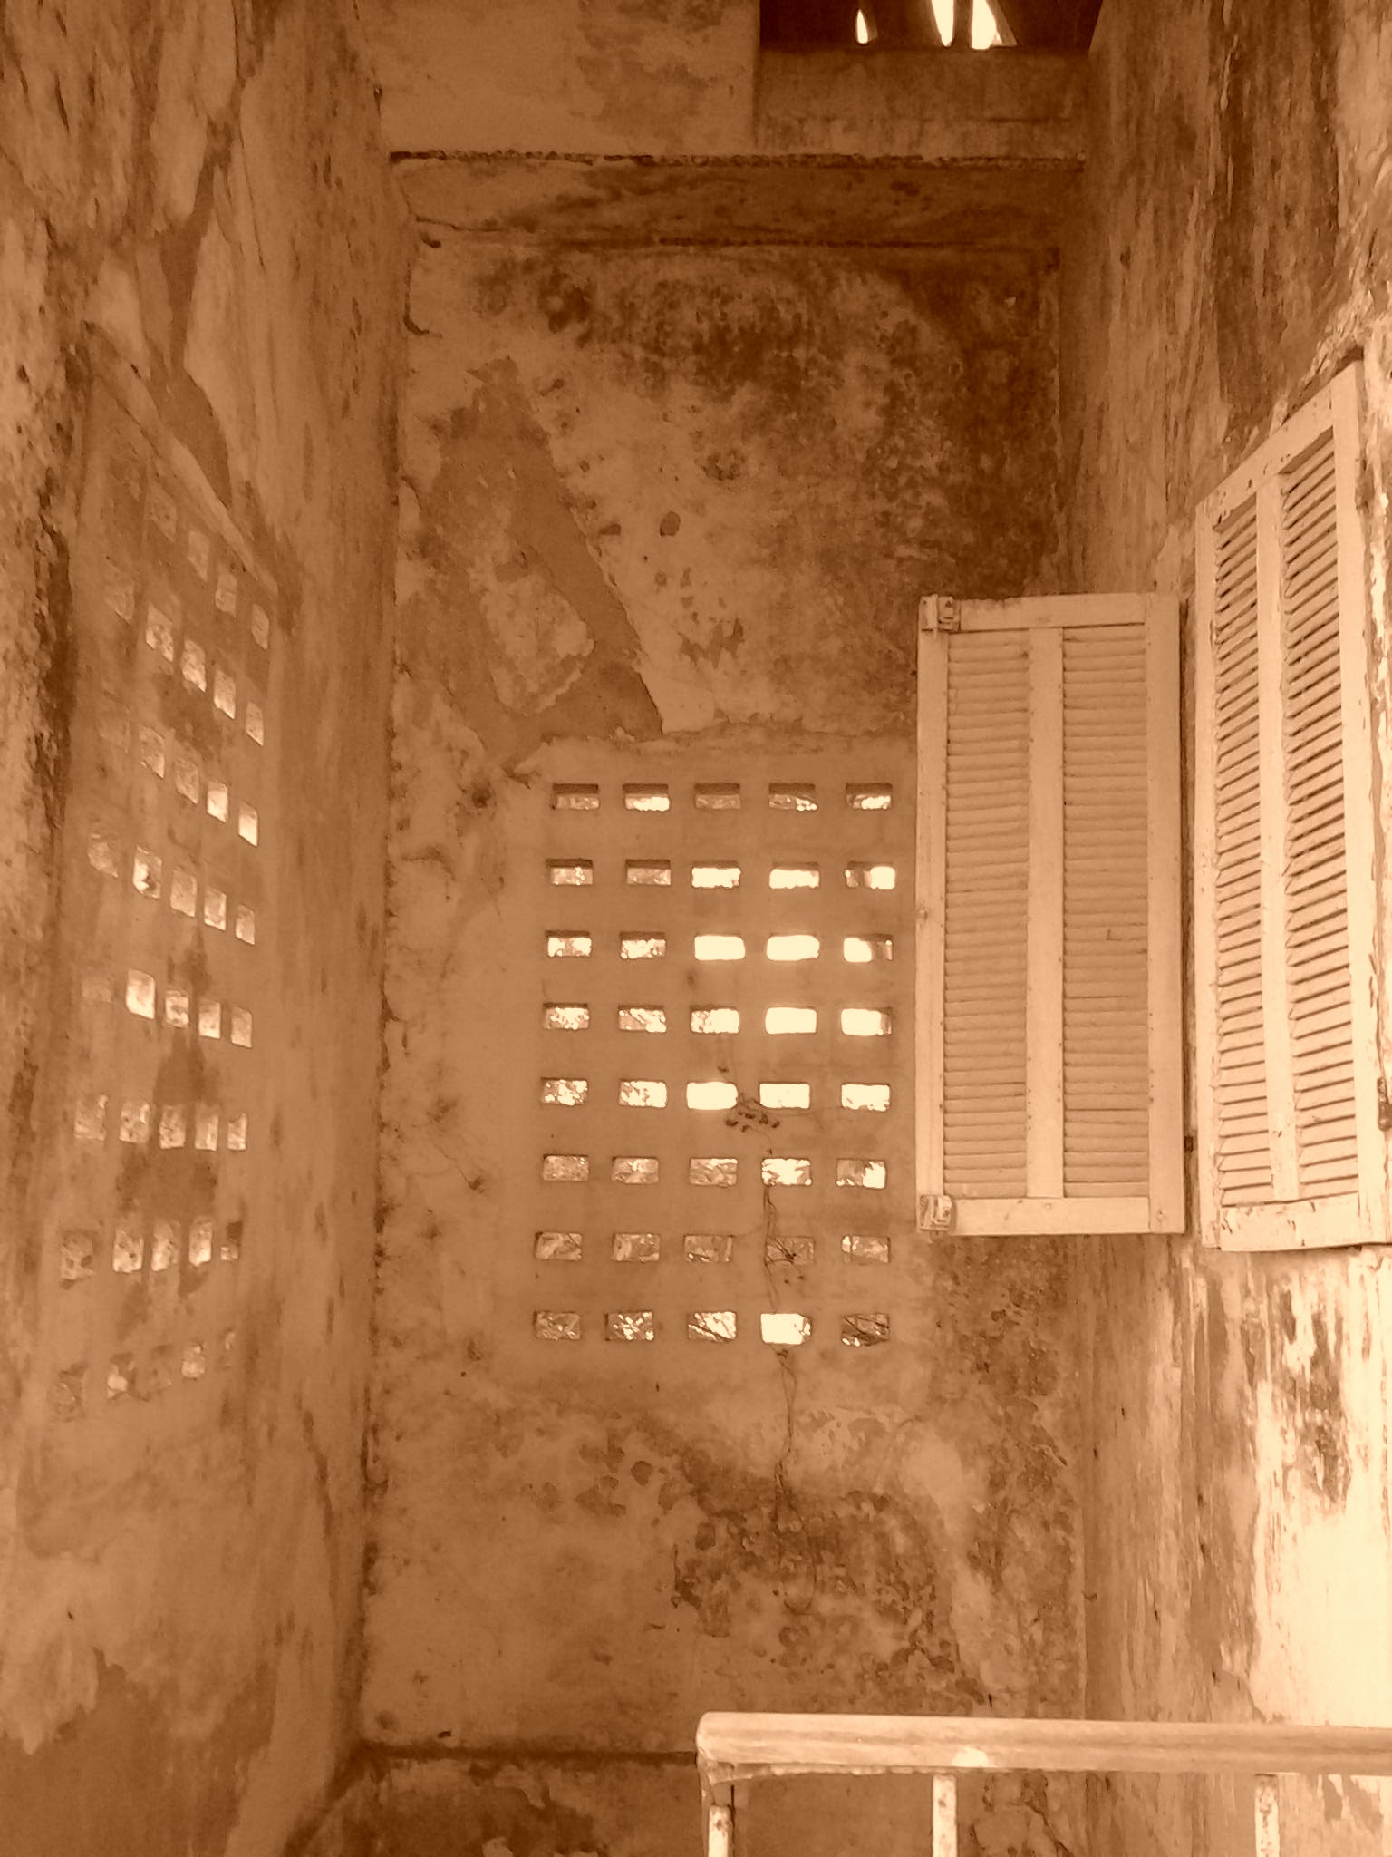
L'ARCHITECTURE ITALIENNE DE SÉDHIOU
ITALIAN ARCHITECTURE RESURGENCE
Le Fort Pinet Laprade (1836) escaliers
Fort Pinet Laprade (1836) stairs

Slide 19
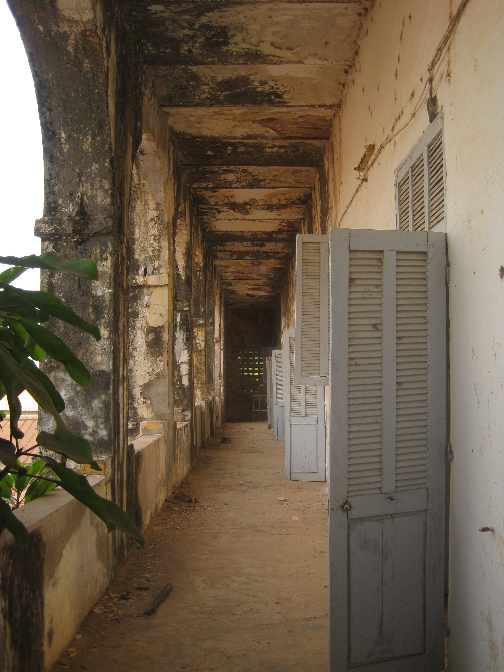
L'ARCHITECTURE ITALIENNE DE SÉDHIOU
Le Fort Pinet Laprade (1836) 2ème étage
ITALIAN ARCHITECTURE RESURGENCE
Fort Pinet Laprade (1836) 2nd floor

Slide 20
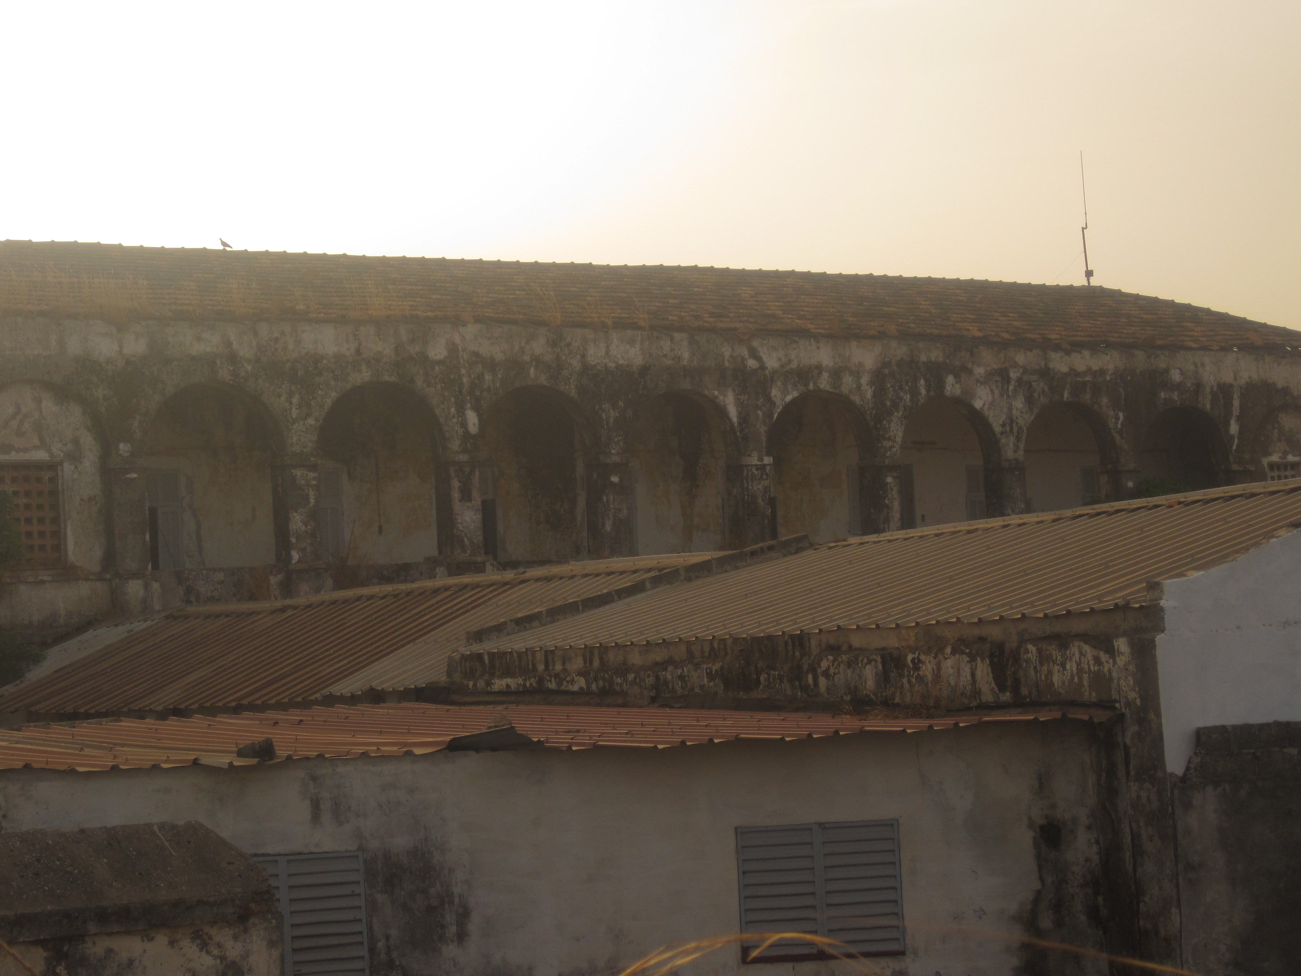
PRESENCE PALLADIENNE EN CASAMANCE
ITALIAN ARCHITECTURE RESURGENT

Slide 21
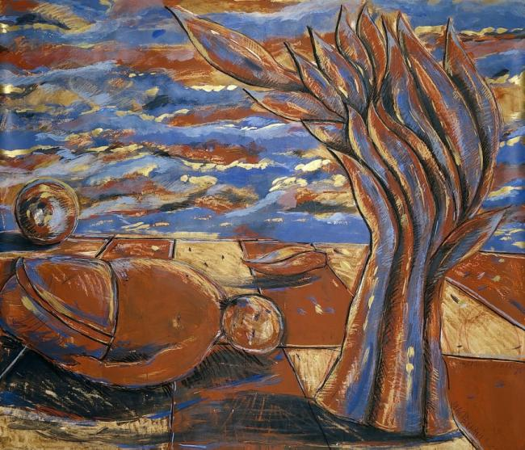
UNE SAISON AU SUD SOUDAN / A Season in Southern Sudan
III. Pas de printemps pour Geronimo / III. No Spring for Geronimo
Retour d’Afrique XIII, 1999, tempera
s/ papier Vinci,130 X 140 cm,
Collection de l'artiste, Paris

Slide 23
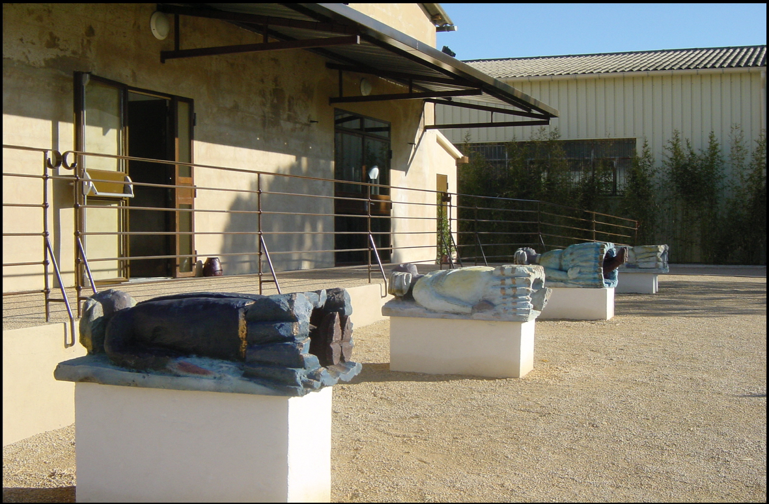

Slide 24
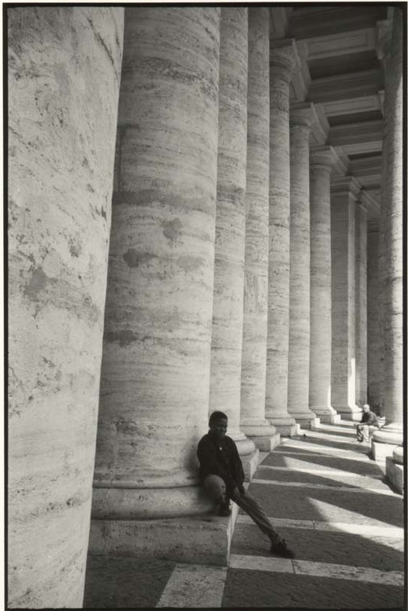
MÉTIS DANS LES VILLES/
METIS IN THE CITIES
I LOVE PARIS, IT 'S MY CITY
I love Paris, it's my city, it belongs to me and I do belong to it;
Born on the Left Bank, willy-nilly I live on the Right Bank.
When I cross the Seine, I feel I am going home;
I love this bridge; I know that one day it will carry me across the Seine.
It is magnificent, royal, with its sculptured emblems of the city;
But nobody sees it;
Nobody sees the Métis either;
They walk alone in the days and nights of the city, where their lives are absorbed as in a black hole;
Paris, this city that they love like a drug, takes more than it gives.
As in an aquarium, they tap against the walls of the city, that seems like a shelter but still so hostile to them.
They do not belong to it.
But why this so beloved city
does rejects me ?
Diagne Chanel.
Rome, 2000,
silver print, 1/8, 24x30 cm

Slide 25
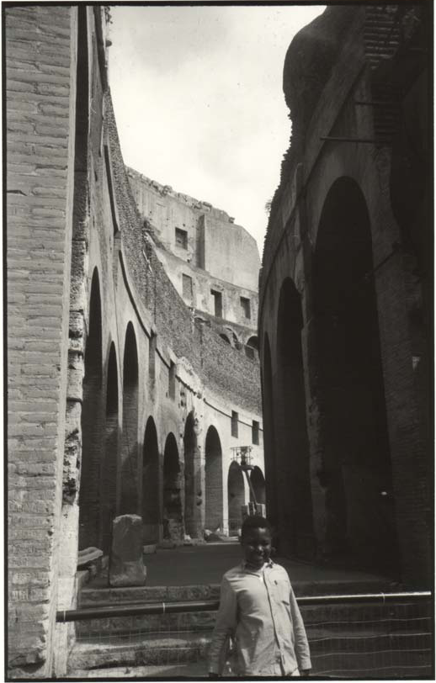
Metis in the City
Rome, Florence: présence palladienne / Palladian Presence in Rome & Florence

Slide 26
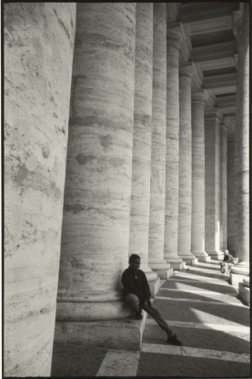
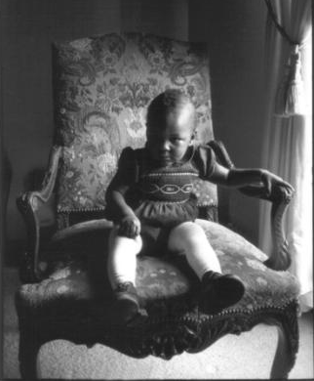
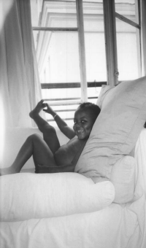
MÉTIS DANS LES VILLES / Metis in the Cities
Dakar / Paris/ Dakar
Métis dans les Villes, Armand, silver print on paper,© Diagne Chanel,
1993, 1995, 2000, Collection de l'artiste

Slide 27


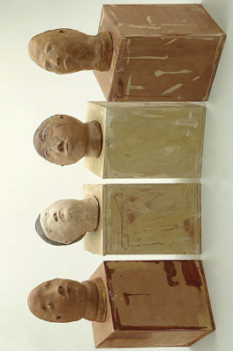
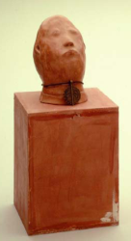
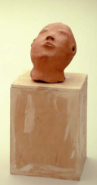
FRUITS ÉTRANGES / Strange Fruits
Strange Fruits for John Garang
Six sculptures, terra cotta, 1998
Southern trees bear a strange fruit
Blood on the leaves and blood at the root
Black body swinging in the Southern breeze
Strange fruit hanging from the poplar trees
Pastoral scene of the gallant South,
The bulging eyes and the twisted mouth,
Scent of magnolia sweet and fresh,
Then the sudden smell of burning flesh!
Here is fruit for the crows to pluck,
For the rain to gather, for the wind to suck,
For the sun to rot, for the trees to drop,
Here is a strange and bitter crop.
Abel Meeropol, 1937

Slide 28
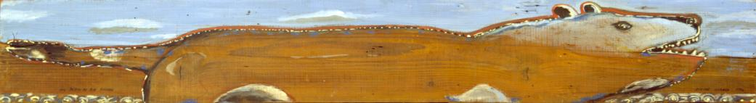
DIAGNE CHANEL in
…Paris, Lyon, Bruxelles, Dakar, Frankfort, Casablanca, Bordeaux, Rome, Fès, Tokyo, Naples, San Francisco, Bayreuth, Amsterdam, Sédhiou, Capetown…
The series Métis in the Cities was produced and staged in 2006.
When Evening comes in 2011, Reverence in Casamance in 2013.
They compose a trilogy recounting these urban and solitary walks, when the night falls.

